Slide 1
Data with Pandas
Karim

Slide 2
About me
Abdulkarim Alabdulkarim
Who?
Full stack Engineer
Professionally 6 years developer
Masters on Information production and systems
Notes:
Recently job hunting so if you want to make a support group for job hunting let me know

Slide 3
Jupyter Notebook
What?
A virtual notebook
• Markdown and Python
• Useful for visualizing and quick coding

Slide 4
Jupyter Notebook
Where?
Online
Kaggle notebook, Google colab
Local
JupyterLab, JupyterNotebook, VS Code
Notes:
Online you could use pay for more memory and share the notebook. Don’t use for productions cause pain to version control %load_ext cudf.pandas

Slide 5
What is Pandas
A Python library for data manipulation and analysis.
Exploring
Analyzing
Cleaning
Notes:
2.0 is built in top of pyArrows, the version before is buit on top of numpy.

Slide 6
Pandas Data Structures
Series.
Think row or column
DataFrame
Think table

Slide 7
Show time
Refer to the “intro” notebook.

Slide 8
When Pandas
Exploratory Data Analysis (EDA).
Simplify manual data manipulation tasks.
Patch Data Manipulation.

Slide 9
Why Pandas
Open Source
Is the de facto standard
Seamlessly integrated with data visualization libraries
Seaborn
Plotly
Notes:
With other ML libraries like scikitlearn

Slide 10
Show time!
Kaggle : Japanese Universities Dataset
Refer to “EDA” notebook.
Refer to Data Card
Notes:
We can look at Kaggle notebooks
https://www.kaggle.com/code/adelanseur/japanese-universities-eda/notebook

Slide 11
You can also
Sort
GroupBy
Merge
More Visualization
Read and write different formats
Read and Write to SQL
Webscrape (read html)

Slide 12
You can also
Speed things with cython
Use GPU with cudf
Parallel compute with dask
Use pyarrow to improve performance
Notes:
(reading and datatypes)

Slide 13
How Pandas
Three Solutions
Loop
Apply
Vectorize
Refer to “ThreeApproaches” notebook.
Or watch this video instead.

Slide 14
Alternatives
Polars
Designed for speed, with Rust.
Lazy Frames.
Supports pandas (import and export)
Spark
Designed for actual big data that doesn’t fit the memory.
Designed for distributed processing .
Notes:
You can also deal with large files with pandas, but you need to chunk them and can get complicated e.g. sorting a big dataset like 20gigs or larger. Lazy frame doesn’t load the data into the memory.

Slide 15
Alternatives
R
Juila
Excel
Notes:
Yeah, seriously excel.

Slide 16

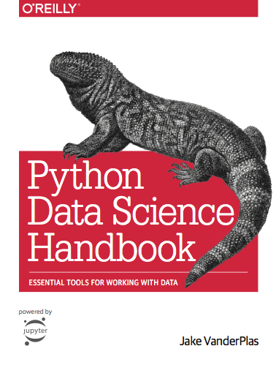
Resources
Video:
Rob Mulla
Playlist:
Pandas - Corey Schafer
7-day bootcamp: Nick Wan
Courses:
Kaggle Learn
UC Berkely – course notes
Notes:
Rob Mulla: “Learning Pandas for Data Analysis? Start Here.”
Nick wan is a Senior Director of Baseball Analytics · Cincinnati Reds

Slide 17
Thank you
Any other questions?

